Slide 1


BY-231- What’s new in Open Text eDOCS DM 5.3
Larry Roy
Director Product Management
November 11, 2010
Rev 2.0 01102010

Slide 2
Agenda
DM 5.3 Overview
Microsoft Office 2010
File Type Enhancements
Lowering Cost of Ownership
Deployment Enhancements
Architectural Enhancements
Miscellaneous

Slide 3
Disclaimer
Certain statements in this presentation constitute forward-looking statements or forward-looking information within the meaning of applicable securities laws (“forward-looking statements”). Such forward-looking statements involve known and unknown risks, uncertainties and other factors that may cause the actual results, performance or achievements of Open Text, or developments in Open Text’s business or in its industry, to differ materially from the anticipated results, performance, achievements or developments expressed or implied by such forward-looking statements. The historical increases in the Company's revenues and earnings do not assure the revenues and earnings will not decrease in the future. Forward-looking statements include all disclosure regarding possible events, conditions or results of operations that is based on assumptions about future economic conditions and courses of action. Forward-looking statements may also include any statement relating to future events, conditions or circumstances. Open Text cautions you not to place undue reliance upon any such forward-looking statements, which speak only as of the date they are made. Forward-looking statements relate to, among other things, changes in the ECM market; the market focus of Open Text, Open Text’s revenue mix and margin targets; Open Text’s operations priorities; and Open Text’s strategy for its products and solutions. The risks and uncertainties that may affect forward-looking statements include, among others, the completion and integration of acquisitions, the possibility of technical, logistical or planning issues in connection with deployments, the continuous commitment of Open Text's customers, demand for Open Text's products and other risks detailed from time to time in Open Text's filings with the Securities and Exchange Commission and Canadian provincial securities regulators, including Open Text's Annual Report on Form 10-K for the year ended June 30, 2010. Forward-looking statements are based on management’s current plans, estimates, projections, beliefs and opinions, and the Company does not undertake any obligation to update forward-looking statements should assumptions related to these plans, estimates, projections, beliefs and opinions change.

Slide 4
eDOCS DM 5.3 Overview
Notes:
Page 4

Slide 5
eDOCS DM 5.3 Release Date
The eDOCS DM 5.3 software is scheduled to be released by November 30.
The complete September 7th customer advisory about extending the eDOCS Beta program can be found by clicking here.

Slide 6

Open Text Document Management, eDOCS Edition (eDOCS DM 5.3)
Delivering enhanced application and platform support
Creating easy to deploy client and server-side installations
Broadening support for multiple file extensions
Creating seamless usage of the Save User Interface throughout
Supporting multiple communication protocols

Slide 7
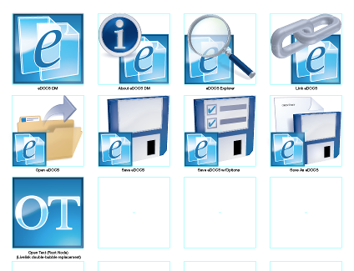
Product Rebranding
Rebranding from Hummingbird to Open Text eDOCS DM
Updated Documentation
New Splash screens
Configuration Screens
eDOCS DM Webtop
Installation Directories

Slide 8
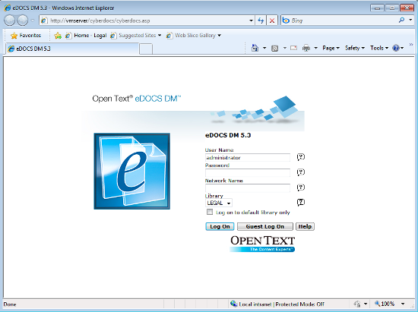
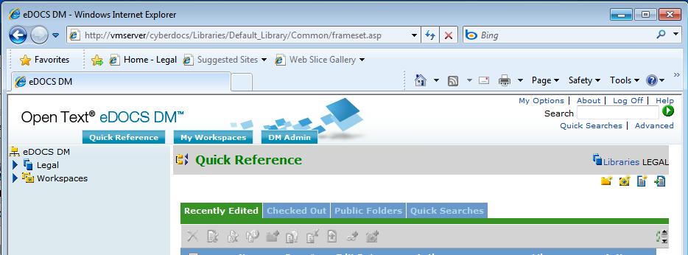
eDOCS DM 5.3 Webtop
Rebranded to Open Text

Slide 9
Microsoft Office 2010
Notes:
Page 9

Slide 10
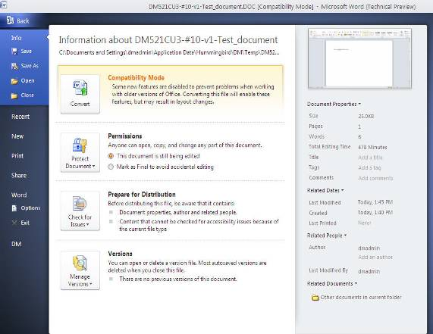
Microsoft Office 2010 Integration
New Integration designed from the “ground up”
Integration files independent of previous versions of Office
Movement from ODMA and COM add-ins for the previous releases to Microsoft’s VSTO only for this release
Integration into the Microsoft Backstage

Slide 11
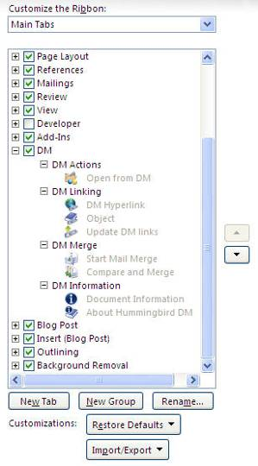
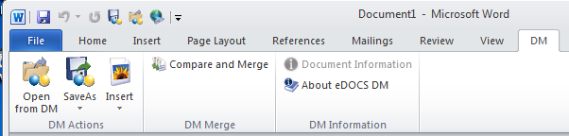
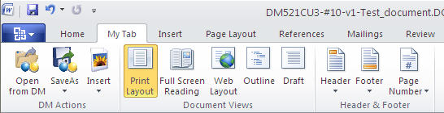
Customize Your Experience
Create your own eDOCS DM Ribbon

Slide 12
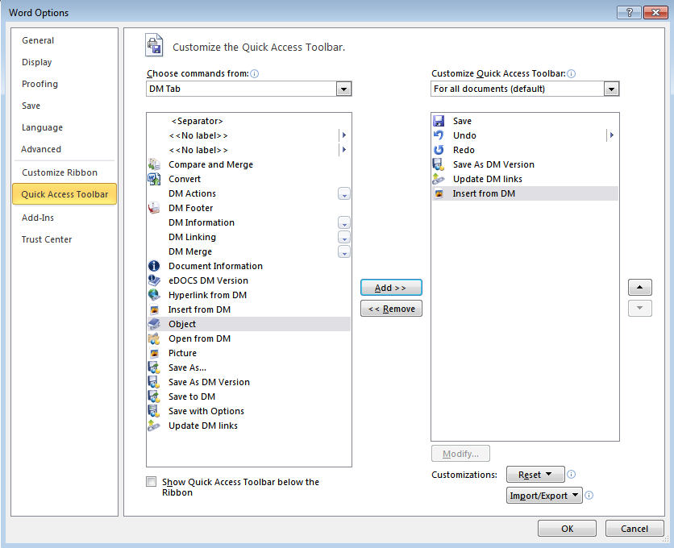
Quick Access Toolbar (QAT)support

Slide 13
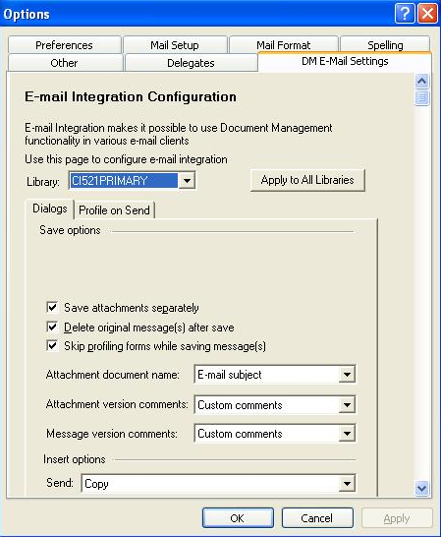
Outlook 2007
Ability for users to configure their eDOCS DM Email settings from the Outlook options tab
Uses can now dynamically update their settings, choosing to save attachments, how to save them: with the message or separately into eDOCS

Slide 14
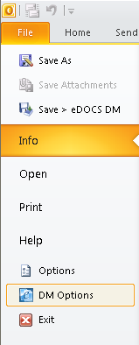
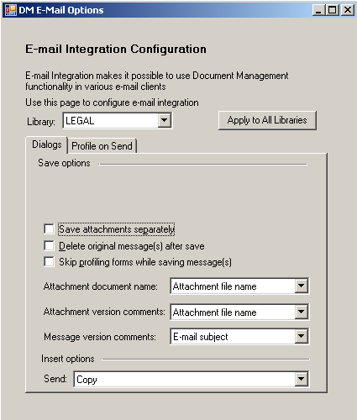
Outlook 2010 Email Options
The DM Options to configure email options is available in the Backstage interface

Slide 15
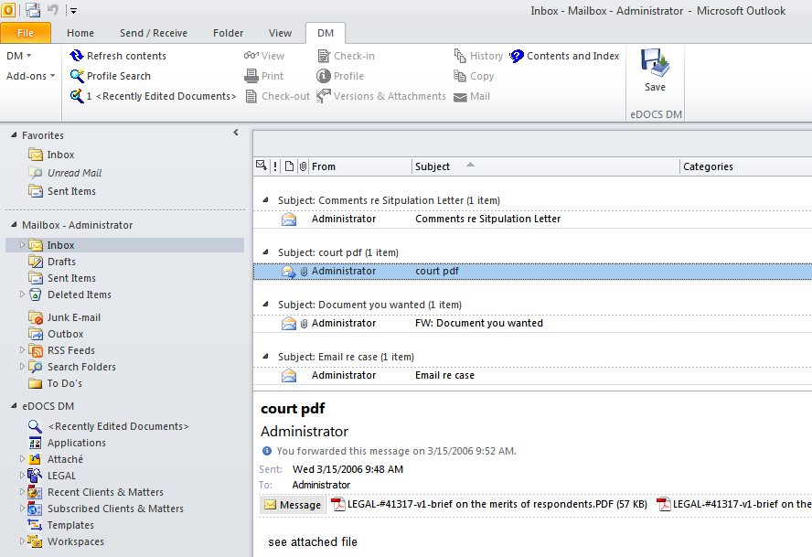
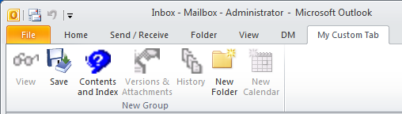
Microsoft Outlook 2010
eDOCS DM Commands are active when the eDOCS node is not selected
eDOCS DM node can be renamed
My eDOCS DM Project…
Integration with the Quick Access Toolbar and Custom Tabs

Slide 16
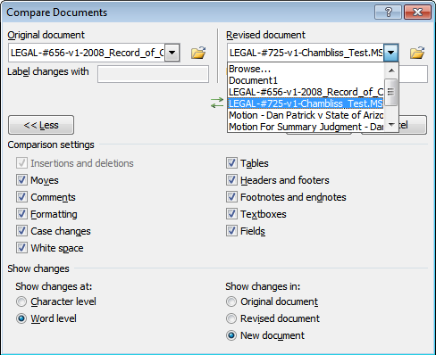
Compare and Merge (2007/2010)
No longer provide an eDOCS custom dialog
Integration with the Native compare dialog brings up a Quick Retrieve when selecting the Open Icon or Browse action.

Slide 17
File Type Enhancements
Notes:
Page 17

Slide 18
Multiple File Types Support
Problem:
Our customers want to save documents which are outside the two file formats currently supported for each Office application: Word, PowerPoint and Excel.
We need to be able to provide the ability to save documents which is closer to the native Office save experience.
Solution:
We have designed the ability for both Office 2007 and Office 2010 to save and open file types which have not been previously supported with eDOCS
This will mimic the native save dialog that appears in native Office save dialogs.
User Scenario
Angela receives a CSV file via email from a client with some accounting data. She needs to include her department information, so she opens the file, makes her edits and chooses save. The eDOCS save dialog opens and from the drop-down she chooses to save the document as an .xlsx file. The document is converted and saved into her document library.

Slide 19
How does it work?
Library generator populates the database with a table: File_Types_Extns
Defaults are populated with native based single file types from each application
Most file extensions are disabled by default to allow for easy configuration after installation

Slide 20
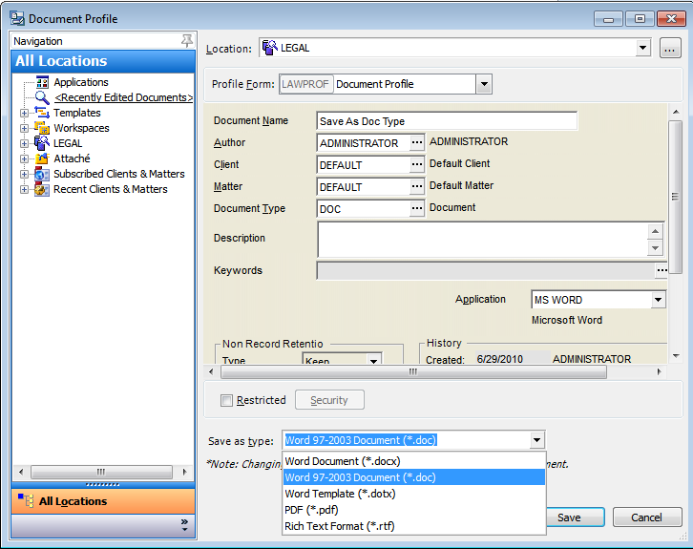
Multiple File Types Support
On the profile form
New dropdown to select document format
New Documents will default to the libraries default extension for the application
Documents which have already been saved will default to the file extension and format in which the document was originally saved

Slide 21
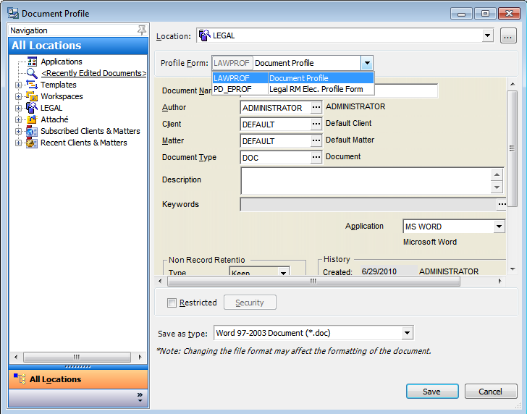
Save User Interface Enhancements
Users can now change the profile form of a document “on the fly”
The form size is adjusted based on the size of the form or the last re-sizing the display of that specific form.

Slide 22
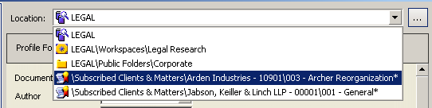
Save User Interface Enhancements (cont.)
The full path of the tree structure is displayed to easily differentiate folders of the same name but in different structures.

Slide 23
Lowering Cost of Ownership
Notes:
Page 23

Slide 24





Updated Platform Support

Slide 25
Client Operating Systems
Windows XP Professional
Windows Vista 32 bit
Windows 7 – 32 bit
Windows 7 – 64 bit
The DM Extensions will be a 32 bit application running on the 64 bit platform

Slide 26
Microsoft Office Suites
Microsoft Office 2010
Using Visual Studio Tools for Office (VSTO)
Includes support for multiple file types
32 bit version
Microsoft Office 2007
Using COM
Includes support for multiple file types
Microsoft Office 2003
COM Automation or ODMA support
We will continue to support Office 2003, but QA will be limited for the release.
This process is similar to the support policy that was described in the DM 5.2.1 CU4 platforms information document
Quick Reference: Applications and Platforms Supported in eDOCS DM/RM 5.2.1 CU4

Slide 27
Other Office Suites & Applications
Lotus Suite 9.8, 9.7
Corel WordPerfect Office X5, X3
Adobe Acrobat 8.0, 9.0.x
Dragon Naturally Speaking 10.1
Freedom Scientific JAWS 11
Lotus Notes 7.0.4, 8.5.2
Novell GroupWise 7.0, 8.0
ODMA for other third party applications

Slide 28
Server Operating Systems / Databases
Windows Server 2003 R2 (32 bit)
Windows Server 2008 R2 (64 Bit)
The DM Server will be a 32 bit application running on the 64 bit server
Microsoft SQL Server 2005, 2008, 2008 R2
Compatibility Mode or SQL-92 (Native Mode)
Oracle 10g R2, 11g R2
Citrix XenServer and XenDesktop
Microsoft Windows Terminal Server
Open Text will support customers who run DM products on supported operating systems, irrespective of whether they are running in a virtual environment or not.

Slide 29
Deployment Enhancements
Notes:
Page 29

Slide 30
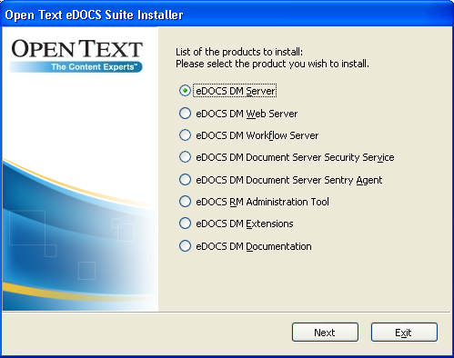
eDOCS DM 5.3 Packaging
The eDOCS DM 5.3 software will be a new ISO image which includes all the MSI installation packages
The eDOCS DM 5.3 software can be installed directly on a new Server or Desktop.
The eDOCS DM 5.3 software will also upgrade an existing 5.1.0.5 / 5.2.1 Server or Extensions to DM 5.3

Slide 31
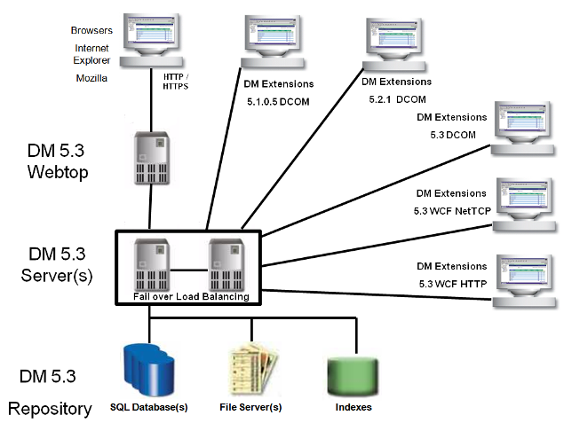
eDOCS DM 5.3 Backwards Compatibility

Slide 32
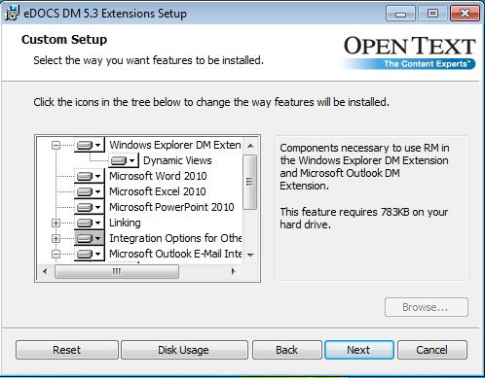
Microsoft Windows Installer (MSI)
The MSI software will detect the version of Office and install the respective integration macros
Users will be able to select which features from the DM Extensions they would like to install

Slide 33
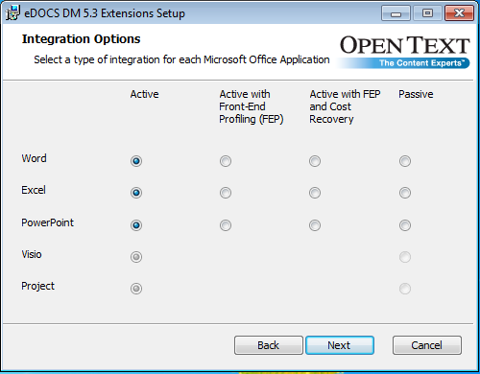
Microsoft Office Integration
If the user is performing the install then the option to select the type of Office integration will be presented

Slide 34
MSI Installations Advantages
Because all MSI installations are transactional, they have a built-in rollback feature for future patches
MSI allows for either full installation of future patches or incremental
MSI allows for installations to run from a group policy and can include additional hotfixes, registry, xml and macro files
Reduced need to reboot after installation (Will inform user if processes are running during an update and ask to shut them down, a reboot will be required if they go ahead without shutting down the process)
Completely customizable based on individual environments
Use ORCA tool for modifying MSI Installations
Windows Installer Development Tools

Slide 35
Using Batch files with Parameters
Non-Silent Install
msiexec /l*v "%TEMP%\dmext.log" /i "C:\eDOCS DM 5.3 Extensions (x86).msi”
Non-silent install with RM and Imaging license info so that when they are selected in the feature tree, the license info dialog won't be displayed.
msiexec /l*v "%TEMP%\dmext.log" /i "C:\eDOCS DM 5.3 Extensions (x86).msi" OT_SERIALNUMBER_28=28-0100-001-00000000 OT_PASSWORD_32=1234abcd OT_SERIALNUMBER_32=32-XXXX-XXX-00000000 OT_PASSWORD_32=XXXX1234

Slide 36
Using Batch files with Parameters (Cont.)
Silent Install with selected features and DM Imaging
msiexec /l*v "%TEMP%\dmext.log" /i "C:\eDOCS DM 5.3 Extensions (x64).msi" /q ADDLOCAL=“DynamicViewsFeature,Microsoft.Word.2010,DMViewer,CDU,ImagingExt” OT_SERIALNUMBER_28=28-XXXX-XXX-00000000 OT_PASSWORD_28=1234XXXX

Slide 37
Architecture Enhancements
Notes:
Page 37

Slide 38
Windows Communication Foundation
Update servers and clients to include support for:
Windows Communication Foundation (WCF)
HTTP
Advantages to using WCF
Tighter control of port usage
Ability to use Microsoft’s WCF logging utilities to diagnose connection problems
Servers will remain backwards compatible
Using the eDOCS DM Client Connection Wizard, client machines can choose which connection to use
Older clients can continue to use DCOM to connect to the eDOCS DM Server without interruption

Slide 39
eDOCS DM 5.3 Miscellaneous
Notes:
Page 39

Slide 40
DM Miscellaneous Features
New Search Operators:
“Plus” variable for date searches, %TODAY to %TODAY plus 30
Field is “EMPTY” or “NOT_EMPTY”
PowerPoint “Reuse Slide” integrated
View native office document properties or DM Document properties separately
Office File convert, changes a document from compatibility mode to native mode, Saves a .DOC to .DOCX as an example

Slide 41
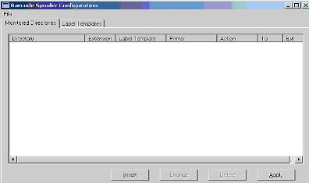
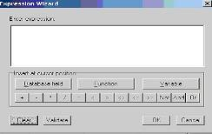
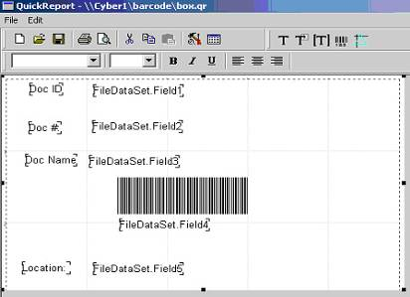
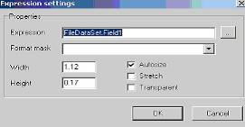
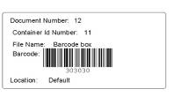
eDOCS RM 5.3
eDOCS RM 5.2.1 functionality
New RM Barcode Tool
Included with the RM Administrator Utility / License
Provides:
Label formatting
Label printing

Slide 42


Slide 43
Thank You

